Slide 1

© 2007 Thomson South-Western

Slide 2
Elasticity . . .
… allows us to analyze supply and demand with greater precision.
… is a measure of how much buyers and sellers respond to changes in market conditions

Slide 3
THE ELASTICITY OF DEMAND
The price elasticity of demand is a measure of how much the quantity demanded of a good responds to a change in the price of that good.
When we talk about elasticity, that responsiveness is always measured in percentage terms.
Specifically, the price elasticity of demand is the percentage change in quantity demanded due to a percentage change in the price.

Slide 4
Computing the Price Elasticity of Demand
The price elasticity of demand is computed as the percentage change in the quantity demanded divided by the percentage change in price.

Slide 5
The Price Elasticity of Demand and Its Determinants
Availability of Close Substitutes
Necessities versus Luxuries
Definition of the Market
Time Horizon

Slide 6
The Price Elasticity of Demand and Its Determinants
Demand tends to be more elastic:
  the larger the number of close substitutes.
  if the good is a luxury.
  the longer the time period.

Slide 7
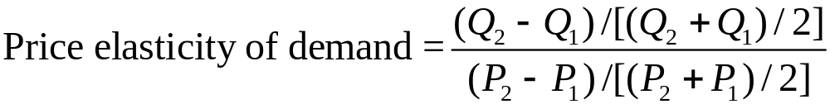
The Midpoint Method: A Better Way to Calculate Percentage Changes and Elasticities
The midpoint formula is preferable when calculating the price elasticity of demand because it gives the same answer regardless of the direction of the price change.

Slide 8
The Midpoint Method: A Better Way to Calculate Percentage Changes and Elasticities
Example: If the price of an ice cream cone increases from $2.00 to $2.20 and the amount you buy falls from 10 to 8 cones, then your elasticity of demand, using the midpoint formula, would be calculated as: x/y, where x=(8-10)/((10+8)/2), and y=(2.20-2.00)/((2.00+2.20)/2)= -2.32

Slide 9
The Variety of Demand Curves
Inelastic Demand
  Quantity demanded does not respond strongly to price changes.
  Absolute Value of Price elasticity of demand is between zero and one.
Elastic Demand
  Quantity demanded responds strongly to changes in price.
  Absolute Value of Price elasticity of demand is greater than one.

Slide 10
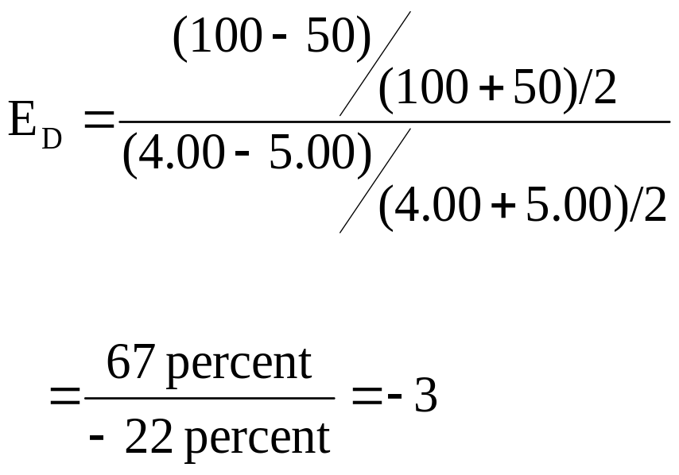
Computing the Price Elasticity of Demand
Price
$5
4
Demand
0
50
100
Quantity
Demand is price elastic.

Slide 11
The Variety of Demand Curves
Perfectly Inelastic
  Quantity demanded does not respond to price changes.
Perfectly Elastic
  Quantity demanded changes infinitely with any change in price.
Unit Elastic
  Quantity demanded changes by the same percentage as the price.

Slide 12
Figure 1 The Price Elasticity of Demand
(a) Perfectly Inelastic Demand: Elasticity Equals 0
Price
Demand
$5
4
1. An
increase
in price . . .
0
100
Quantity
2. . . . leaves the quantity demanded unchanged.

Slide 13
The Variety of Demand Curves
Because the price elasticity of demand measures how much quantity demanded responds to the price, it is closely related to the slope of the demand curve.
But it is not the same thing as the slope!

Slide 14
Own-Price Elasticity of Demand
p₁
p₁
slope
= - 2
slope
= - 0.2
10
10
5
X₁*
50
X₁*
In which case is the quantity demanded
X₁* more sensitive to changes to p₁?

Slide 15
Own-Price Elasticity of Demand
p₁
p₁
slope
= - 2
slope
= - 0.2
10
10
5
X₁*
50
X₁*
In which case is the quantity demanded
X₁* more sensitive to changes to p₁?

Slide 16
Own-Price Elasticity of Demand
10-packs
Single Units
p₁
p₁
slope
= - 2
slope
= - 0.2
10
10
5
X₁*
50
X₁*
In which case is the quantity demanded
X₁* more sensitive to changes to p₁?

Slide 17
Own-Price Elasticity of Demand
10-packs
Single Units
p₁
p₁
slope
= - 2
slope
= - 0.2
10
10
5
X₁*
50
X₁*
In which case is the quantity demanded
X₁* more sensitive to changes to p₁?
It is the same in both cases.

Slide 18
Own-Price Elasticity of Demand
Q: Why not just use the slope of a demand curve to measure the sensitivity of quantity demanded to a change in a commodity’s own price?
A: Because the value of sensitivity then depends upon the (arbitrary) units of measurement used for quantity demanded.

Slide 19
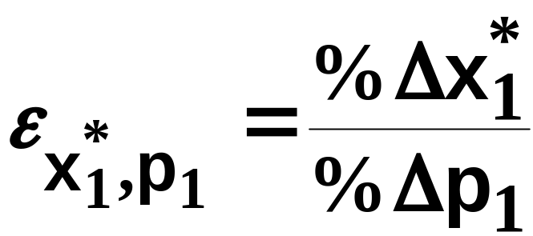
Own-Price Elasticity of Demand
is a ratio of percentages and so has no
units of measurement.
Hence own-price elasticity of demand is a sensitivity measure that is independent of units of measurement.

Slide 20
Figure 1 The Price Elasticity of Demand
(b) Inelastic Demand: Absolute value of Elasticity Is Between 0 and 1
Price
$5
4
1. A 22%
Demand
increase
in price . . .
0
90
100
Quantity
2. . . . leads to an 11% decrease in quantity demanded.

Slide 21
Figure 1 The Price Elasticity of Demand
(c) Unit Elastic Demand: Absolute value of Elasticity Equals 1
Price
$5
4
1. A 22%
Demand
increase
in price . . .
0
80
100
Quantity
2. . . . leads to a 22% decrease in quantity demanded.

Slide 22
Figure 1 The Price Elasticity of Demand
(d) Elastic Demand: Absolute value of Elasticity Is Greater Than 1
Price
$5
4
Demand
1. A 22%
increase
in price . . .
0
50
100
Quantity
2. . . . leads to a 67% decrease in quantity demanded.

Slide 23
Figure 1 The Price Elasticity of Demand
(e) Perfectly Elastic Demand: Absolute value of Elasticity Equals Infinity
Price
1. At any price
above $4, quantity
demanded is zero.
$4
Demand
2. At exactly $4,
consumers will
buy any quantity.
0
Quantity
3. At a price below $4,
quantity demanded is infinite.

Slide 24

Total Revenue and the Price Elasticity of Demand
Total revenue is the amount paid by buyers and received by sellers of a good.
Computed as the price of the good times the quantity sold.

Slide 25
Figure 2 Total Revenue
Price
When the price is $4, consumers will demand 100 units, and spend $400 on this good.
$4
P × Q = $400
P
(revenue)
Demand
0
100
Quantity
Q

Slide 26
Elasticity and Total Revenue along a Linear Demand Curve
With an inelastic demand curve, an increase in price leads to a decrease in quantity that is proportionately smaller. Thus, total revenue increases.

Slide 27
Figure 3 How Total Revenue Changes When Price Changes: Inelastic Demand
Price
Price
An Increase in price from $1
to $3 …
… leads to an Increase in total revenue from $100 to $240
$3
Revenue = $240
$1
Revenue = $100
Demand
Demand
0
100
Quantity
0
80
Quantity

Slide 28
Elasticity and Total Revenue along a Linear Demand Curve
With an elastic demand curve, an increase in the price leads to a decrease in quantity demanded that is proportionately larger. Thus, total revenue decreases.

Slide 29
Figure 3 How Total Revenue Changes When Price Changes: Elastic Demand
Price
Price
An Increase in price from $4
to $5 …
… leads to an decrease in total revenue from $200 to $100
$5
$4
Demand
Demand
Revenue = $200
Revenue = $100
0
50
Quantity
0
20
Quantity
Note that with each price increase, the Law of Demand still holds – an increase in price leads to a decrease in the quantity demanded. It is the change in TR that varies!

Slide 30
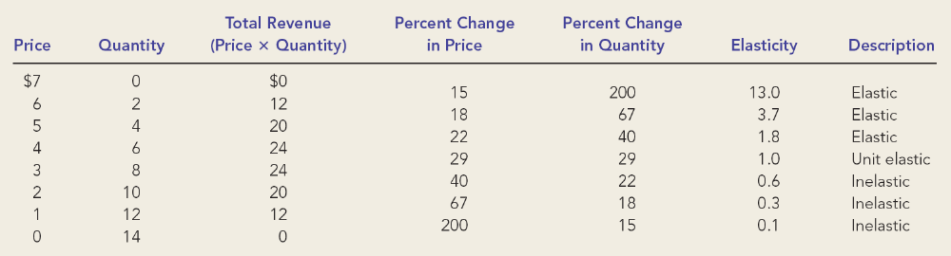
Elasticity of a Linear Demand Curve

Slide 31
Figure 4 Elasticity of a Linear Demand Curve
Demand is elastic; demand is responsive to changes in price.
When price increases from $4 to $5, TR declines from $24 to $20.
Price
$7
Absolute value of Elasticity is > 1 in this range.
6
5
4
Absolute value of Elasticity is < 1 in this range.
Demand is inelastic; demand is not very responsive to changes in price.
3
2
When price increases from $2 to $3, TR increases from $20 to $24.
1
0
2
4
6
8
10
12
14
Quantity

Slide 32
Other Demand Elasticities
Income Elasticity of Demand
  Income elasticity of demand measures how much the quantity demanded of a good responds to a change in consumers’ income.
  It is computed as the percentage change in the quantity demanded divided by the percentage change in income.

Slide 33
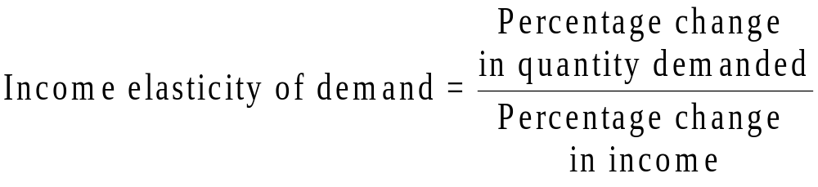
Other Demand Elasticities
Computing Income Elasticity
Remember, all elasticities are measured by dividing one percentage change by another

Slide 34
Other Demand Elasticities
Income Elasticity
  Types of Goods
    Normal Goods: Income elasticity is positive
    Inferior Goods: Income elasticity is negative
  Higher income raises the quantity demanded for normal goods but lowers the quantity demanded for inferior goods.

Slide 35
Other Demand Elasticities
Income Elasticity
  Goods consumers regard as necessities tend to be income inelastic
    Examples include food, fuel, clothing, utilities, and medical services.
  Goods consumers regard as luxuries tend to be income elastic.
    Examples include sports cars, furs, and expensive foods.

Slide 36
Other Demand Elasticities
Cross-price elasticity of demand
  A measure of how much the quantity demanded of one good responds to a change in the price of another good, computed as the percentage change in quantity demanded of the first good divided by the percentage change in the price of the second good
  For complements, cross price elasticity is negative
  For substitutes, cross price elasticity is positive

